Slide 1

Joining Tables
Steve Perry
Email: steveperrymail@yahoo.com

Slide 2
Joining Tables
Explicit Join in FROM
Joins are implicitly expressed in the WHERE clause
Notes:
1

Slide 3
Two Tables at a Time
Can Join Only Two Tables at a Time
Use 'JOIN' keyword in the FROM clause
Use 'Connecting' Columns in the WHERE clause
datatypes must match or convert correctly
More than one Join operation can be specified in a Single SELECT statement
Notes:
2

Slide 4
Join Syntax – FROM Clause
SELECT select_list FROM table_1 JOIN table_2
{USING (col_1) | ON (col_1 operator col_2) }
Notes:
3

Slide 5
Examples
SELECT title, name FROM book JOIN publisher USING (pub_id);
SELECT title, name FROM book JOIN publisher
ON (book.pub_id = publisher.pub_id);
Qualify the column names with the table names with there is ambiguity
Notes:
4

Slide 6
Aliases
Remember you can use short names as aliases for the table names
SELECT title, name FROM book t JOIN publisher p ON (t.pub_id = p.pub_id);
Notes:
5

Slide 7
Example
Find the author(s) of the Secrets of Silicon Valley
SELECT lastname, firstname, title FROM author
JOIN bookauthor USING (ssn)
JOIN book
USING (isbn)
WHERE title = ‘Secrets of Silicon Valley’;
Notes:
6

Slide 8
Unplanned Joins
Joins may be planned
Primary Keys
Foreign Keys
Joins do not have to be planned
e.g. you may join the "city" column on the authors and editors table
Notes:
7

Slide 9
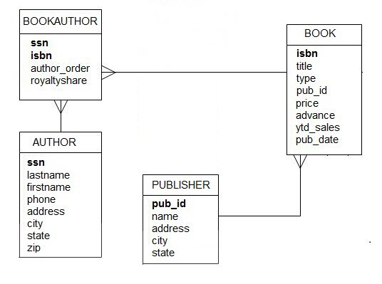
Database Diagram

Slide 10
Join Operators
> greater than
>= greater than or equal to
< less than
<= less than or equal to
< > not equal to

Slide 11
Column Compatibility
Join columns need not have the same name
They should be of the same datatype (or convert to the same datatype)
The join should be meaningful
NULLs found in connecting columns will never join.

Slide 12
Example
Show a list of all authors that live in the same city where the ‘Algodata Infosystems’ publisher is based
SELECT lastname, firstname, city FROM author JOIN publisher USING (city) WHERE name = ‘Algodata Infosystems’;

Slide 13
Data Replication
Rows are returned for every successful join
Returned rows may replicate data for display. (This does not change the data.)

Slide 14
Exercise
Show a list of the authors whose last name is ‘Ringer’ and the city they live in, but only if they have written any books. Put in last name order.

Slide 15
Answer
SELECT lastname, firstname, city FROM author JOIN bookauthor
USING (ssn) WHERE lastname = ‘Ringer’;
If no join is made from an author (ssn) to the bookauthor table then the author has not written any books.

Slide 16
Joining More than Two Tables
We can only join two tables at a time… … but we can do more than one ‘two-table’ join in a Select statement.

Slide 17
Exercise
Show a list of books and the authors who’ve written them.
Remember: Many-to-Many relationships are modeled with an association/bridging table
Need to join three tables to get information from both associated tables.

Slide 18
Database Diagram

Slide 19
Answer
SELECT lastname, firstname, title FROM authors JOIN bookauthor USING (ssn) JOIN book USING (isbn)
ORDER BY 1, 2, 3

Slide 20
Another Exercise
Show a list of books (by book title) and the number of authors that have written each book, if more than one author wrote the book.

Slide 21
Answer
SELECT title, count(ssn) FROM book JOIN bookauthor USING (isbn)
GROUP BY title HAVING count(ssn) > 1 ORDER BY title

Slide 22
Last Slide

